Slide 1
Learning by Semantic Similarity Makes Abstractive Summarization Better
https://github.com/icml-2020-nlp/semsim
ICML-20
瞿春霞
2021年3月14日

Slide 2
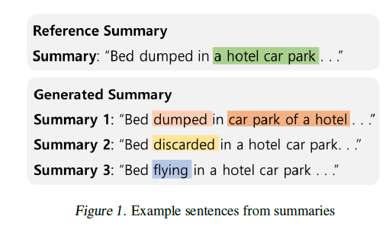
Example----ISSUE
Semantically analogous to the reference summary

Slide 3
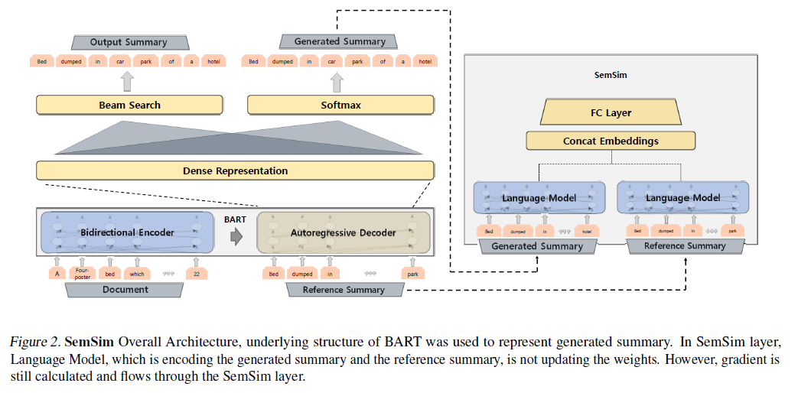
SemSim

Slide 4
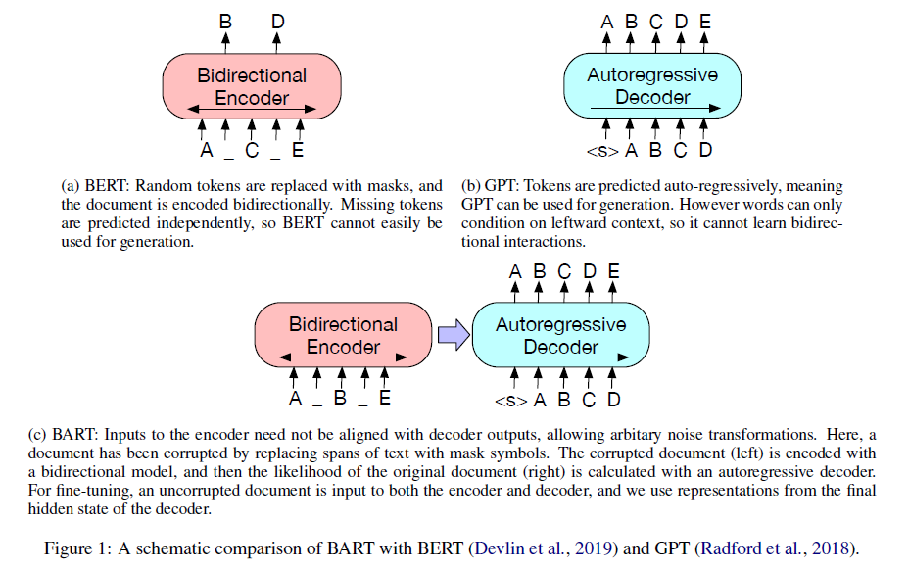
SemSim ---BART

Slide 5
SemSim------Semantic Similarity (SemSim) layer
maximum-likelihood loss:
Embeddings:
semantic similarity score:
semantic similarity loss:
training objective:

Slide 6
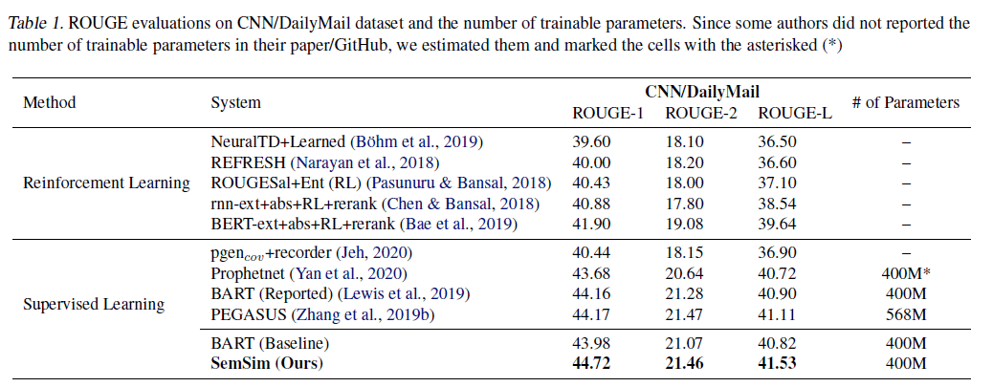
Result

